Slide 1
Skilled Technical Workforce Pathways
Data Science for the Public Good, Summer 2019
Vicki Lancaster, Ph.D., Alyssa Fowers, Sarah McDonald, and Calvin Isch

Slide 2
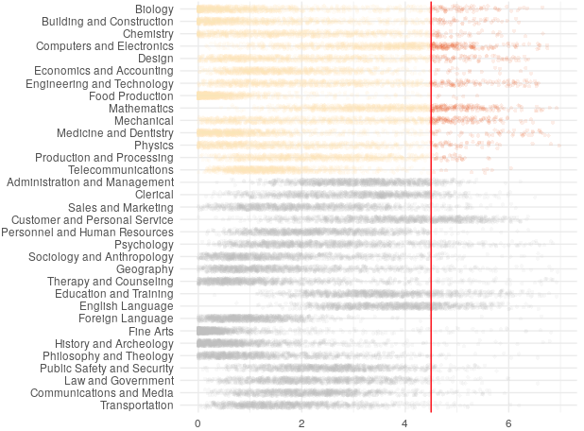
What Is Skilled Technical Work?
Positions that require a high level of technical knowledge, but do not require a bachelor’s degree
Pathway to the middle class without requiring college education
Critical to success of American economy and industry
Fewer than 20% of occupations require a high level
of technical knowledge
High Level of Knowledge
Technical knowledge
Types of Knowledge
Non-technical knowledge
Source: O*NET survey
Rating of knowledge required for each occupation

Slide 3
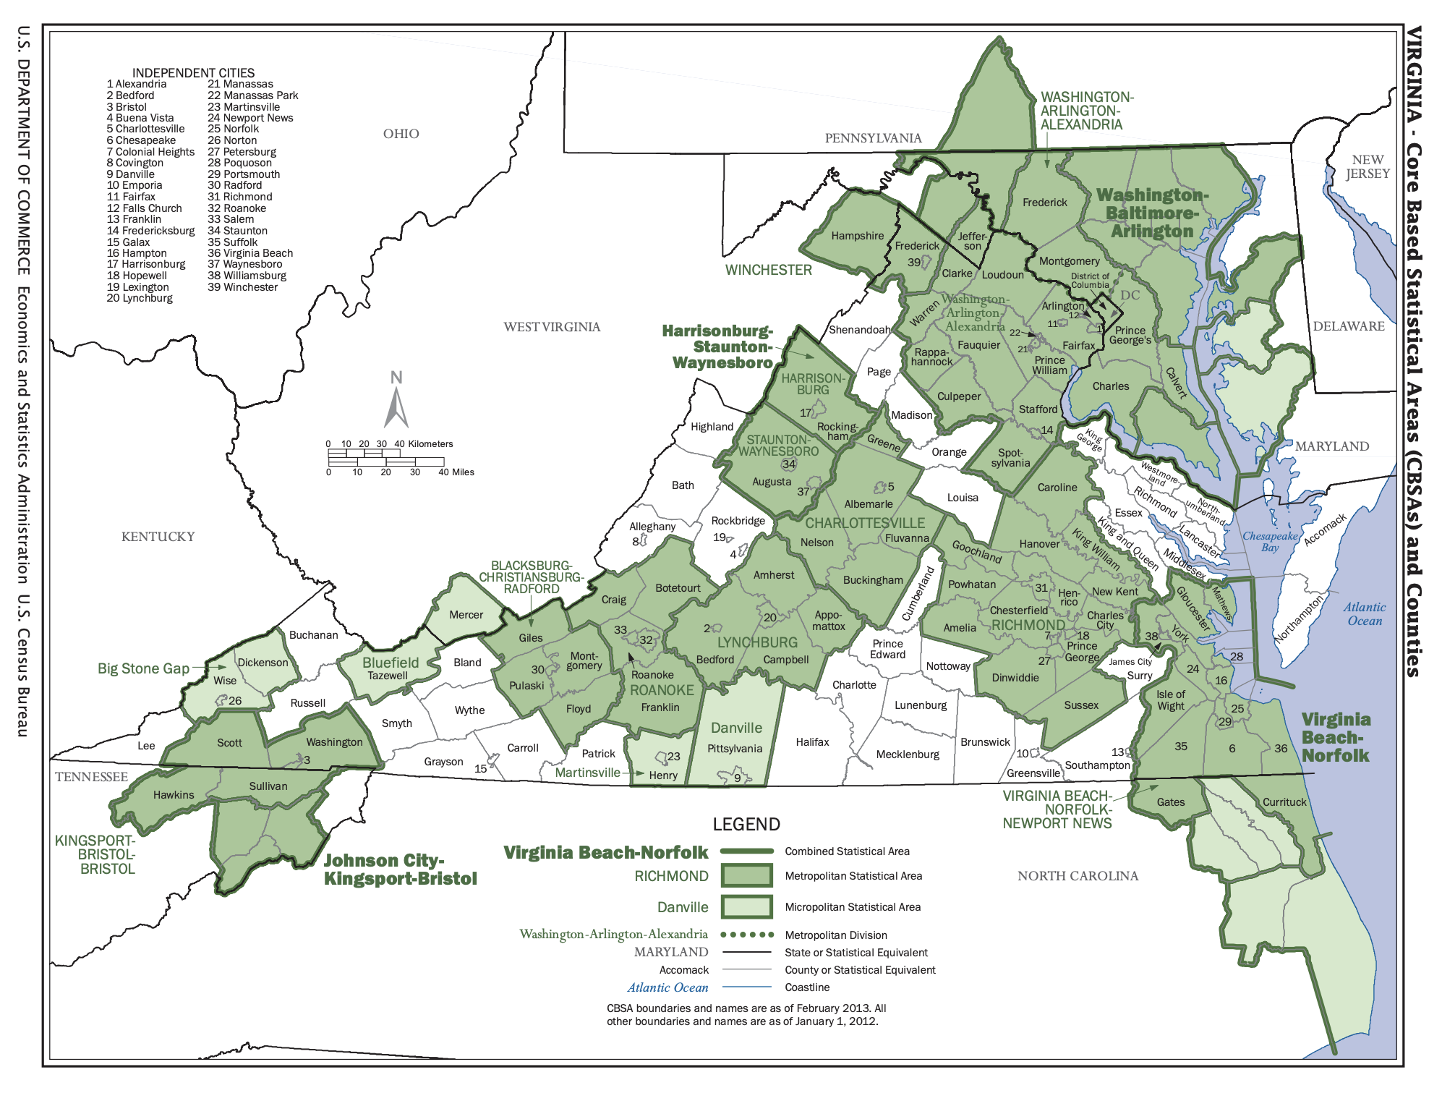
Focus on Richmond and Blacksburg
Examining two metropolitan statistical areas in 2017:
  Richmond and Blacksburg
  Completely contained within Virginia
  “Quarantined” from each other by distance

Slide 4
Research Questions
For individuals with an Associate’s degree or less in Virginia, what are the pathways to non-degree credentials that will provide them with the skills necessary to secure a job in the skilled technical workforce (STW)?
Can we develop a metric that will identify the weak points in the pathway that can be useful for job seekers, policy makers, and educators?
Can this proof of concept be extended to other states?

Slide 5
Data Pathways
Which jobs qualify as skilled technical work?
What skills are
required for local STW positions?
What skills do employers need?
Skilled Technical Worker definition (Rothwell)
Job Ads
(Burning Glass)
O*NET codes
Do local educational opportunities match the local job market?
What skills are missing from the workforce?
BGT skills classifications
?
?
Are there opportunities to gain missing skills and credentials?
Educational Opportunities
Resumes
(Burning Glass)
What skills do job seekers already have?
How can job seekers gain new skills and credentials?

Slide 6
What skilled technical positions are available? What skills are required for those jobs?
Where can residents train for skilled technical positions?
What skills do local workers already have?
Local Job Market
Current Workforce
Educational Opportunities
Do the skills required by the job market match the skills of the local workforce?
Do local educational opportunities prepare workers for in-demand local jobs?

Slide 7
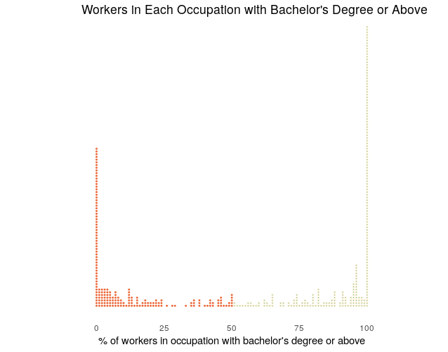
Defining Occupations in the Skilled Technical Workforce
Rothwell (2015) identifies 179 STW occupations based on two questions:
1. Which occupations require a high level of technical knowledge?
2. Which technical occupations are largely performed by workers without bachelor's degrees?
Each dot is the level of knowledge needed for a specific occupation. Every occupation is rated between 1-7 for every type of knowledge.
Below Rothwell threshold
Above Rothwell threshold
One dot = one occupation
Orange dots are occupations where <50% of workers have bachelor's degrees
Yellow dots are occupations where >50% of workers have bachelor's degrees
Technical knowledge
Non-technical knowledge
Percent of workers in occupation with bachelor's degree or above
Source: O*NET survey
Knowledge required for each occupation
Source: O*NET survey

Slide 8
Describing the Local Job Market With Online Job Ads
What skilled technical positions are available? What skills are required for those jobs?
Local Job Market
Current Workforce
Educational Opportunities

Slide 9

Burning Glass Technologies* (BGT) delivers job market analytics that empowers employers, workers, and educators to make labor market data-driven decisions.¹
50,000
sites daily
70
variables
2007-19
*!(08 & 09)
* https://www.burning-glass.com/about/

Slide 10
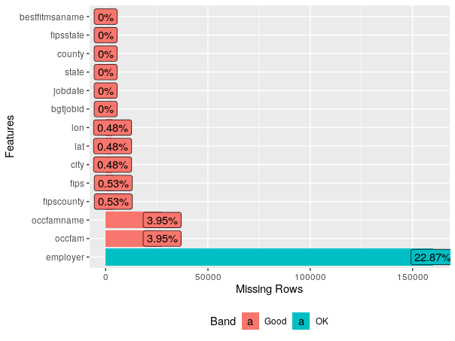
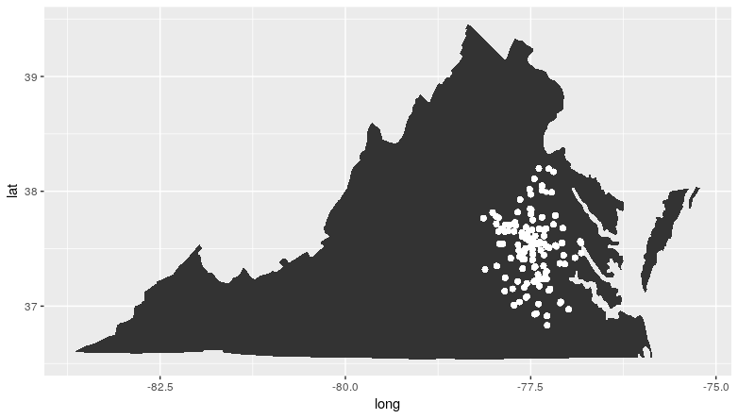
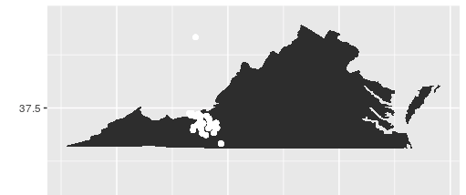
Job Ad Data Description
Job-ad Data
5 data files: main, skills, major, degrees, & certifications
699,754 unique job postings in Virginia in 2017
Example of Data Profiling for Completeness
99,997 unique postings for Richmond MSA
11,232 unique postings for Blacksburg MSA

Slide 11
Describing the Current Workforce with Online Resumes
What skilled technical positions are available? What skills are required for those jobs?
What skills do local workers already have?
Local Job Market
Current Workforce
Educational Opportunities

Slide 12
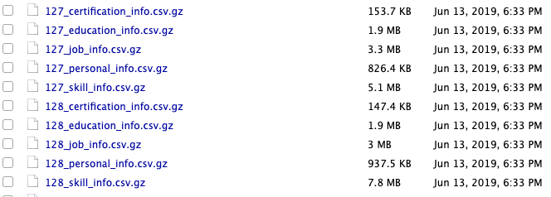
Resume Data Description
The resume dataset is a BGT proprietary dataset, sourced from Burning Glass partners.
  demographics, career path, education, certifications, skills, and employers.
Untested in the literature except for Burning Glass (BGT)
Track career pathways and skills for the two MSAs
2,200 files
Hard to link—not impossible

Slide 13
Connecting Ads to Resumes With Burning Glass Skills Data
Local Job Market
Current Workforce
Educational Opportunities
Do the skills required by the job market match the skills of the local workforce?

Slide 14
Investigating Local Educational Opportunities
Where can residents train for skilled technical positions?
Local Job Market
Current Workforce
Educational Opportunities

Slide 15
Investigating Local Educational Opportunities
Apprenticeships
Certificate programs
Traditional Education
Associate's degrees
Local Job Market
Current Workforce
Educational Opportunities
Non-Traditional Education
Non-Traditional Education
Massively open online courses
Coding bootcamps
Certifications

Slide 16
Education Data - Providers of Traditional Credentials
State Council of Higher Education for Virginia (SCHEV)
  Colleges and Universities
Department of Labor and Industry (Virginia DOLI)
  Apprenticeships
Virginia Department of Education (VDOE)
  High School Career and Technical Schools
Virginia Community Colleges System (VCCS)
  Credentials

Slide 17
Investigating Local Educational Opportunities
Apprenticeships
Certificate programs
Traditional Education
Associate's degrees
Local Job Market
Current Workforce
Educational Opportunities
Massively open online courses
Non-Traditional Education
Coding bootcamps
Certifications
Non-Traditional Education
Massively open online courses
Coding bootcamps
Certifications

Slide 18

Education Data - Providers of Alternative Credentials
CareerOneStop
  Certification
  Licenses
  Professional Associations
  Apprenticeship
Challenge: Connecting provider list to students in our MSAs

Slide 19

Education Data - Providers of Alternative Credentials
Credential Engine Registry
  Apprenticeship Certificate
  Associate Degree
  Bachelor Degree
  Badge
  Certificate
  Degree
  Digital Badge
  Diploma
  Doctoral Degree
  General Education Development
  Journeyman Certificate
  Licenses
  Master Certificate
  Master Degree
  MicroCredential
  OpenBadge
  Professional Doctorate
  Quality Assurance Credential
  Research Doctorate
  Secondary School Diploma
Challenge: Connecting provider lists to students in our MSAs

Slide 20



Education Data - Providers of Alternative Credentials
Class Central
  Massive Online Open Courses (MOOCs)
Course Report & Switchup
  Coding Bootcamps
Challenge: Connecting provider lists to students in our MSAs

Slide 21
Connections and Mismatch
Apprenticeships
Certificate programs
Traditional Education
Associate's degrees
Local Job Market
Current Workforce
Educational Opportunities
Massively open online courses
Non-Traditional Education
Do the skills required by the job market match the skills of the local workforce?
Coding bootcamps
Certifications
Non-Traditional Education
Do local educational opportunities prepare workers for in-demand local jobs?
Massively open online courses
Coding bootcamps
Certifications

Slide 22
Measuring Mismatch
Mismatch metric from Berkes, Mohnen, and Taska (2018):
  Employer's perspective: are there enough workers with the right skills to fill open jobs?
  Job-seeker's perspective: are there enough jobs that match skillset of local workers?
Education: Mutual Information Index to get linkage strength between careers and educational paths, compare to local educational opportunities

Slide 23
Ethics
Biases in the data
  Some non-traditional providers guarantee a job after program completion, so the BGT resume data may not be comprehensive
  The BGT job data may be skewed toward jobs requiring higher levels of education
  The education data will not be comprehensive of every non-traditional education route
  The project, for now, only focuses on two MSAs

Slide 24
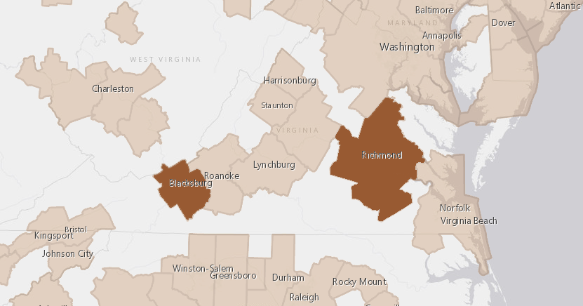
Progress and Plans
Data discovery
Data profiling
Construction of metric to capture mismatch
Determine best definition of STW
Exploratory data analysis
Analysis of pathways to STW credentials and mismatch in Virginia

